Slide 1
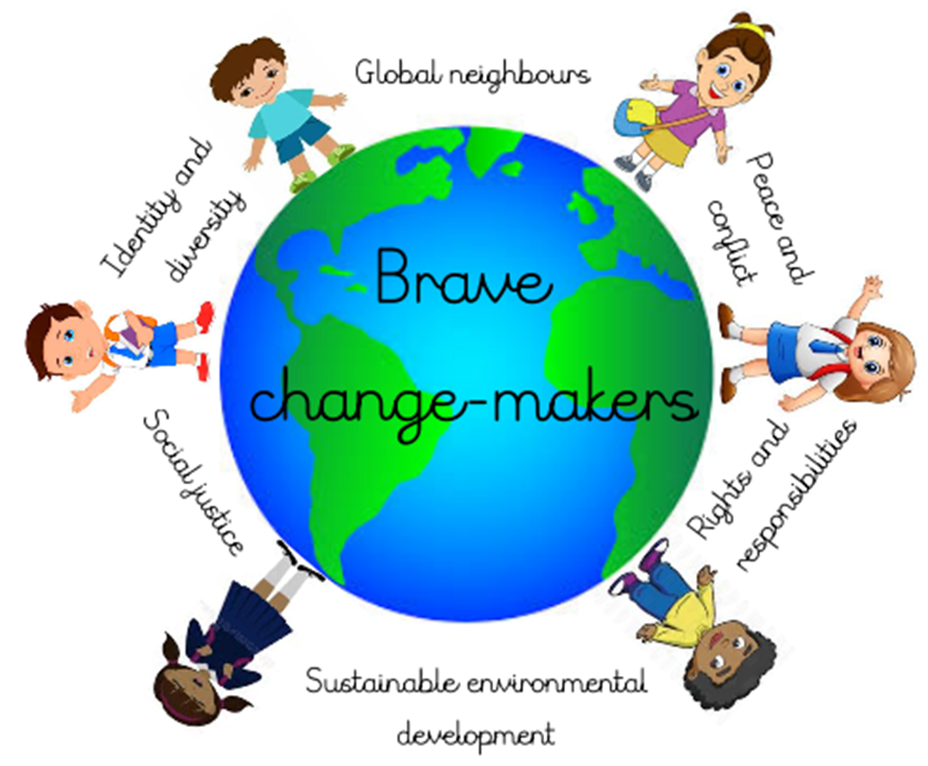



Spring Term 3 2021 Reception
Connected Curriculum Theme: Rights and Responsibilities
EYFS link: Understanding the world: past and present
‘Talk about the lives of the people around them and their roles in society.’
Brave Change-makers Outcome:
Mini product: An interview with a police officer!
Maxi product: A piece of art which will contribute to our school art gallery.
Our Big Question: How do rules help us?
Learning Questions: Why do we need rules?
What rules do we have in school?
What rules do we have when crossing the road?
Some Facts (Knowledge & Understanding) | Skills
Rules are special instructions that we all try to follow. They help us learn how to do things safely and help to make sure everyone in the class can learn and play happily. We have rules in school because there are lot of people here and we need to make sure that we are being kind to each other. We have rules in school to make sure that we are all involved, included and having a good time while we are learning. Rules can be for anyone. Adults at work have to follow rules too. They make sure they can do their job properly and that they are kept safe. | Cooperation and Conflict resolution - Children will participate in group activities, take turns, share and manage disputes peacefully. Making decisions – Children will be able to support others in a group.
Vocabulary Dozen
Please see Dojo fortnightly for our updated vocabulary

Slide 2




Subject | Term 2 Learning
Drawing Club texts | W1/ 2/3 W4/W5 W6/W7
Communication and Language | Circle Time Listen attentively to others, speak clearly to explain ideas, thoughts and feelings. Drawing Club Learn and practise new vocabulary (4 words a week), listen to and talk about stories, engage in conversation with friends and adults, speak clearly to explain ideas and thoughts. Choosing (CP) including Play Projects Practise using new vocabulary, develop social phrases, engage in conversation with friends and adults, speak clearly to explain ideas and thoughts, engage in and talk about books, retell stories and create their own. Story/song time Learn new vocabulary, engage in and talk about books, learn rhymes, poems and songs
Mathematics | Exploring pattern Introducing zero Comparing numbers to 5 and reasoning (1 more/1 less) Composition of numbers to 5 Number bonds to 5
Phonics | Phase 3 Letters and sounds concentrating on segmenting and blending skills. Writing captions and sentences. Key words – Practising list of words to recognise by sight.
Religious Education | Which stories are special and why?
Physical Education | Moving and Handling – wake and shake, action songs using different body parts, travelling in different ways, making obstacle courses, fine and gross motor activities: water painting, ribbon dancing, use different implements with dominant hand, write dance, dough disco, controlling a large ball, chasing and racing games negotiating space successfully, Health and Self Care – Healthy routines: washing hands, toileting, healthy eating, exercise, trying different types of fruit. Understand need for safety when tackling new challenges: Forest Fridays, using equipment safely.
Expressive Arts and Design | Printing with a range of objects Junk model – join with tape/glue and embellish
Jigsaw | Dreams and goals

