Slide 1
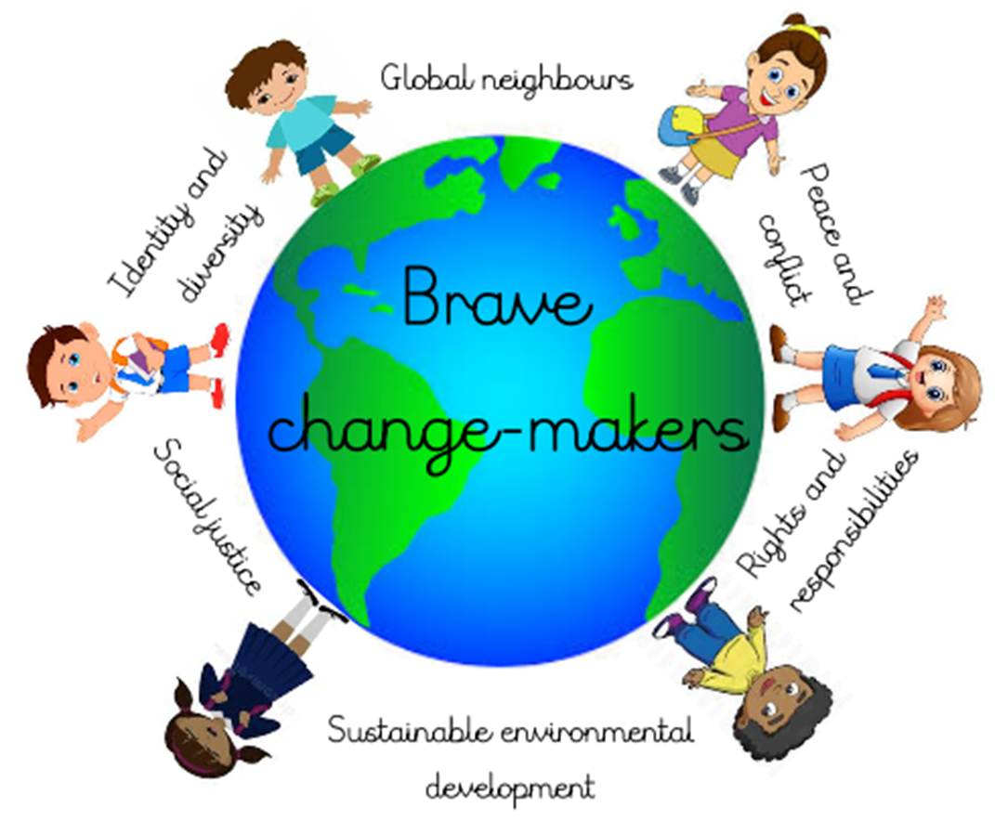
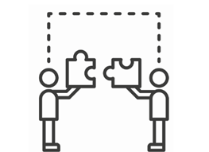
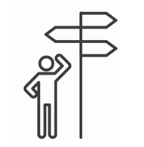
Summer Term 1 2022 Reception
Connected Curriculum Theme: Global Neighbours
EYFS link: Understanding the world; The Natural world:
Explore the natural world around them, making observations and drawing
pictures of animals and plants.
Know some similarities and differences between the natural world
around them and contrasting environments, drawing on their experiences
and what has been read in class.
Brave Change-makers Outcome:
We will be making our very own mini beast homes using recycled and natural items. Children will design, make and decorate their homes before choosing a special place for them in our outdoor area.
Our Big Question: Who lives in a home like this?
Some Facts (Knowledge & Understanding) | Skills
Minibeasts are small creatures, like worms, snails, insects and spiders. The scientific term for them is invertebrates, which means that they don’t have a backbone. Minibeasts are really important in protecting all the beautiful nature that surrounds us. They are eaten by other creatures and they help to pollinate plants. Humans would not survive without minibeasts, so we need to make sure we take care of them and their habitats. When you are outdoors, you will find minibeasts nearly everywhere you look. They live under logs and stones, and in leaf piles, ponds, trees, bushes, grass and soil. Some like it dark and dry and others like it warm and wet. Minibeasts can live in most habitats, from a desert to a lake. The children will be developing an understanding of their immediate and local environment and start to make simple links with other places. Throughout the term we will be considering how we can make our environment better. | Cooperation and Conflict resolution - children will participate in group activities, take turns and share and manage disputes peacefully. Making decisions - children will be able to support others in group or class.
Vocabulary Dozen
Please see Dojo fortnightly for our updated vocabulary.

Slide 2
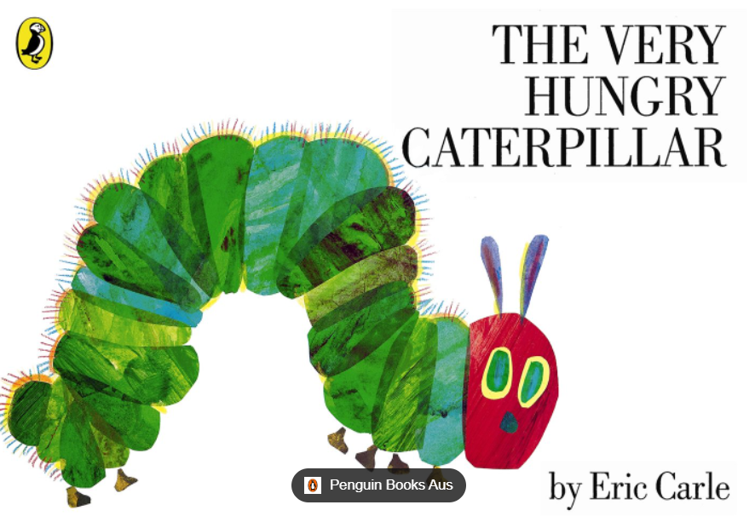
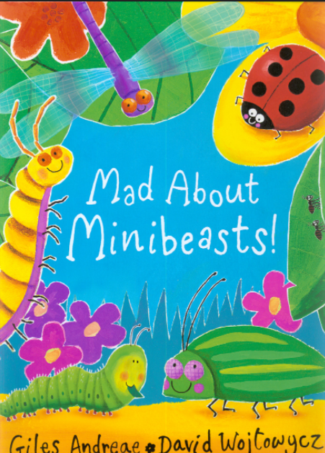
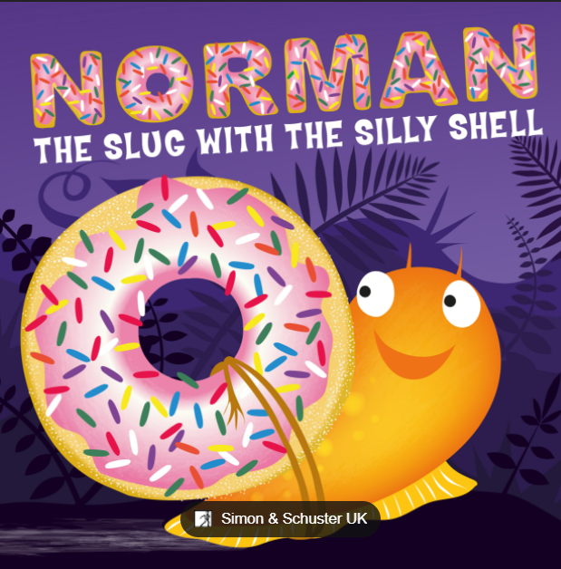
Subject | Term 5 Learning
Drawing Club texts | W1/ W2 W3/W4 W5
Mathematics | Consolidation of the composition of numbers 6-10 Number bonds to 10 Sharing and grouping items fairly Odd and evens Doubles to 10
Phonics | Phase 3 Letters and sounds consolidation, concentrating on segmenting and blending skills. Writing captions and sentences. Key words – Practising list of words to recognise by sight. Phase 4 letters and sounds. In Phase 4 children are not taught any new phonemes or graphemes. Instead, they are taught to further manipulate the phonemes and graphemes they have already learnt. Many of the words children explored in Phase 2 and 3 were monosyllabic (words of one syllable). In Phase 4 children explore more polysyllabic words (words containing more than one syllable). Many of the words in Phase 2 and 3 required children to blend approximately three sounds together in order to read them. Phase 4 requires children to blend an increasing number of sounds together in order to read.
Religious Education | Which people are special and why?
Physical Education | Children will be challenged through a variety range of gross and fine motor activities and games which develop the children's balance, coordination, strength, control and agility.
Expressive Arts and Design | The children will be encouraged to use resources to create their own music, dance and narratives through play. We will make models of minibeasts, learn minibeast themed songs and combine materials and textures to create our own minibeast themed artwork.
Understanding the world: | We will be: ● Learning facts about different minibeasts and their habitats. ● Learning about the life cycles of butterflies and frogs. ● Explore the minibeasts living in our local environment e.g gardens and outdoor spaces. ● We will talk about our own local environment and how we are able to help look after our environment
Jigsaw | Healthy me; How we can keep happy and healthy by the choices we make.

