Slide 1
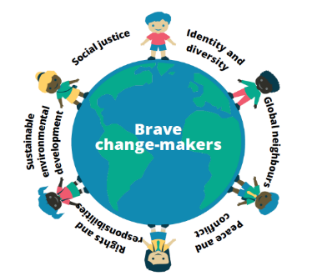
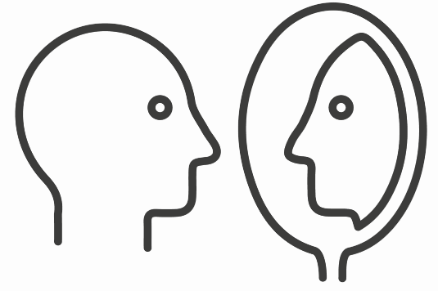
Summer Term 2022 Year 1 (KS1)
Connected Curriculum Theme: Sustainable Environmental Development
Global Theme Progression: Positive and negative impacts of people’s actions (including own personal choices) on others and the environment. How people can damage or improve the environment.
Global Theme Attitudes: Concern for the environment and commitment to sustainable development
Topic: History will focus on the significant event of plastic being invented. Geography will focus on a local area and how it has changed over time from an environmental perspective.
Our Big Question: How can human’s negative behaviour impact the environment?
Term 5 Learning Questions:
When/how/who invented plastic?
What is plastic used for? How does it change overtime?
What is the impact on the environment?
Term 6 Learning Questions:
How has the local area changed over the last 30 years?
Why has Bristol Zoo chosen to relocate to The Wild Place?
How do we ensure the animals are moving to a sustainable environment? How can we make the environment at The Wild Place much more environmentally friendly?
How can we raise awareness of environmental change and make a difference?
Visit: Marine biologist – TBC
Term 6 Maxi Product Outcome: Sponsored walk to raise money for a charity e.g. Green Spaces/Deforestation. Develop a video to raise awareness and encourage donations.
Some Facts (Knowledge & Understanding) | Skills
THE FIRST SYNTHETIC PLASTICS By the middle of the 19th century, in the wake of industrialised goods production, some animal-derived materials had become increasingly scarce. Elephants were facing extinction if demand for their ivory, used in items from piano keys to billiard balls, continued. The same fate awaited some species of turtle, whose shell was harnessed for combs. Inventors soon attempted to tackle this environmental and economic problem, with many patents for new semi-synthetic materials based on natural substances such as cork, blood and milk. One of the earliest was cellulose nitrate—cotton fibres dissolved in nitric and sulphuric acids then mixed with vegetable oil. Its inventor, the Birmingham-born Alexander Parkes, patented this new material in 1862 as Parkesine. Considered the first manufactured plastic, it was a cheap and colourful substitute for ivory or tortoiseshell. | Self-awareness and reflection - Children will be able to recognise effects of own behaviour on others and use this to help make choices. The children will be able to identify matters that are important to self and others and will learn from mistakes and feedback. Cooperation and conflict resolution - Children will be able to play and work cooperatively by helping to ensure that everyone in own group is included. They will begin to show tact and diplomacy.
Vocabulary Dozen
Sustainable | Sustainability is the idea that humans must interact with the environment in a way that ensures there will be enough resources left for future generations. | Compare | Estimate, measure, or note the similarity or dissimilarity between.
Reusable | Able to be used again or more than once. | Fieldwork | Scientific research, exploration, or observation conducted outside of the classroom.
Environment | The surroundings or conditions in which a person, animal, or plant lives or operates. | Urban | Urban areas are areas where many people live and work, resulting in very dense development. The population density is higher than in the surrounding area. It is where buildings are close together. Urban is the opposite of rural, where farm lands and nature are.
Manufactured | Produced on a large scale using machinery. | Recycling | The action or process of converting waste into reusable material.
Invented | Create or design (something that has not existed before); be the originator of. | Impact | A marked effect or influence.
Observation | The action or process of closely observing or monitoring something or someone. | Facilities | A place, amenity, or piece of equipment provided for a particular purpose.

Slide 2
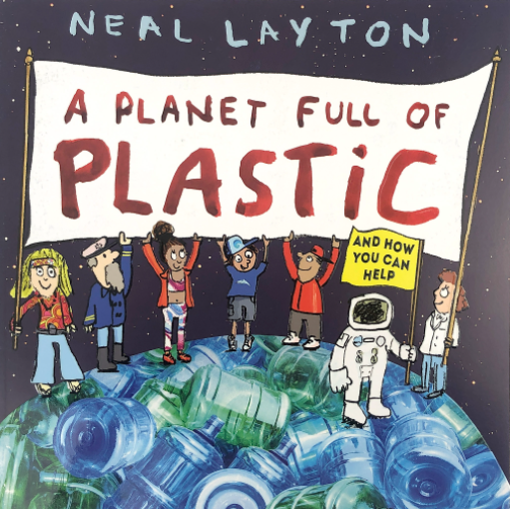
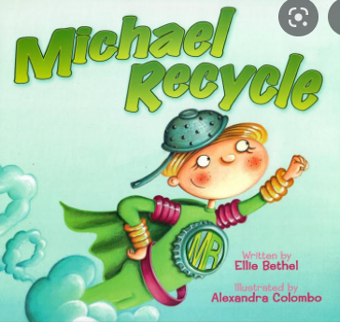
Subject | Term 5 Learning
Core Text & Writing | Week 1 and 2: Fantasy narrative Animation from Literacy Shed: Something Fishy https://www.literacyshed.com/something-fishy.html | Week 3: Instructions on how to make a sock fish. | Week 4 and 5: Non-chronological report Core text: A planet full of plastic/ Michael Recycle
Reading Skills | Continuation of phase 5 and applying phonic knowledge and skills to decode words Reading words containing the suffixes –s, -es, -ing, -ed, -er and –est Reading words containing contractions e.g. I’m, I’ll, we’ll and understand that the apostrophe represent the omitted letter(s) Make predictions and inferences about the text
Mathematics | Multiplication and Division: Counting in steps of 2s, 5s and 10s, making equal groups, adding equal groups, making arrays, making doubles, grouping and sharing. Fractions: Making a half, finding a half, making a quarter, finding a quarter.
Science | Materials: identify and name everyday materials, describe the physical properties of materials, compare and group materials based on their physical properties.
Religious Education | How should we care for others and the world (Judaism link).
Computing | Programming using BeeBots
Physical Education | Dance (oceans) Catching
Geography | Focus on a local area and how it has changed over time from an environmental perspective.
History | The significant event of plastic being invented.
Art and DT | 3D Sculpture – Create an ocean scene and sea creatures from recycled materials Textiles – Create a sock fish
Jigsaw | Relationships
Music | ‘Imagination’ – focus being on rhythm, beat and using imagination. Style of music – pop

